Slide 1
Section 6: Noise of a dynamical scatterer
Farkas Dániel Gergely
MSc student

Slide 2
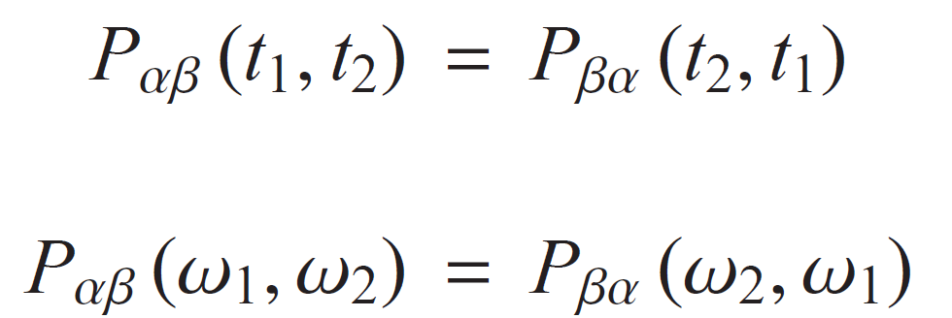
Reminder
(Symmetrized) current correlator:
Fourier transformation => frequency space:
We got:

Slide 3
Noise spectral power
In case of a periodic dynamic scatterer:
We can compare with the case of a stationary scatterer:
We write as sum of four quantities:

Slide 4
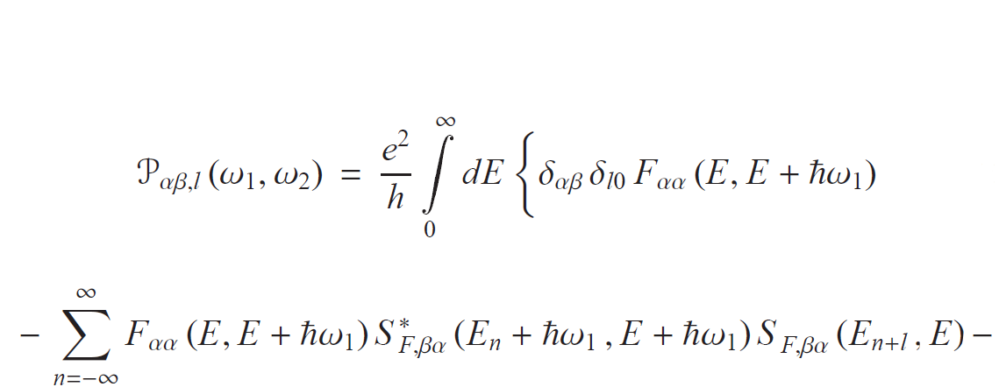
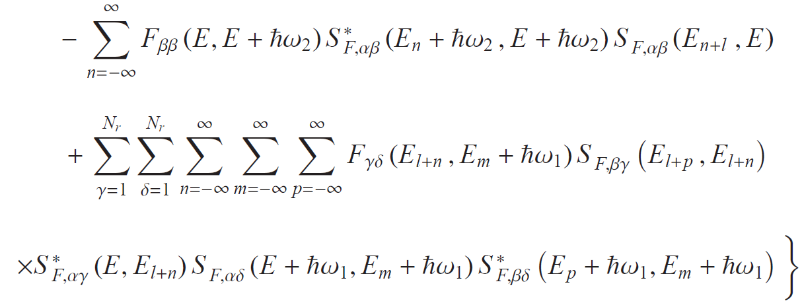
Noise spectral power
We will get the following expression:

Slide 5
Noise spectral power
We start with i, j = in, in
Incidet electrons didn’t interact with the scatterer
=> same than the stationary case:

Slide 6
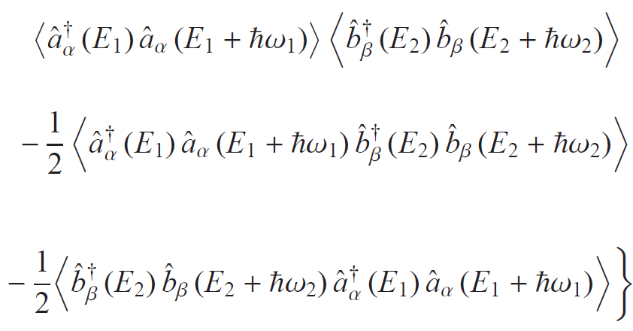
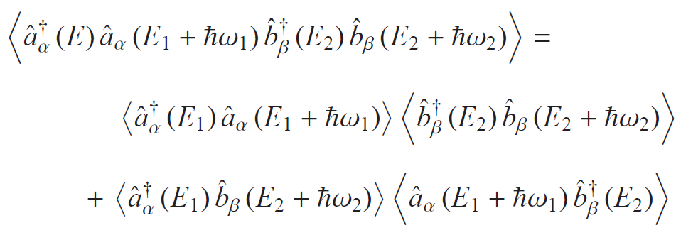
Noise spectral power
i, j = in, out:
Wick’s theorem:

Slide 7
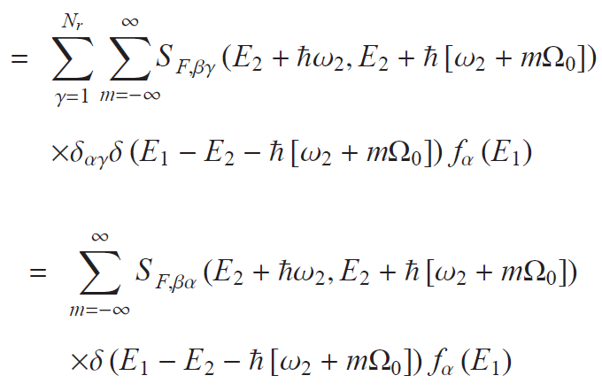
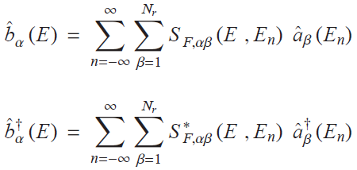
Noise spectral power
We substitute to Wick’s expression:
Scattered electron operators:

Slide 8
Noise spectral power
By analogy, we can calculate the other terms too,
After some further calculation, we get:
„Out, in” term is much alike this one (α -> β, ω₁ -> ω₂):

Slide 9
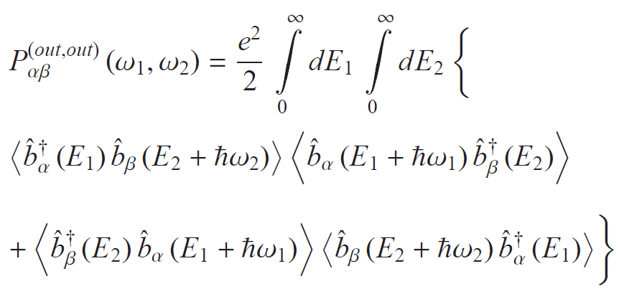
Noise spectral power
Last term: i, j = out, out:
We can express these terms like before,

Slide 10
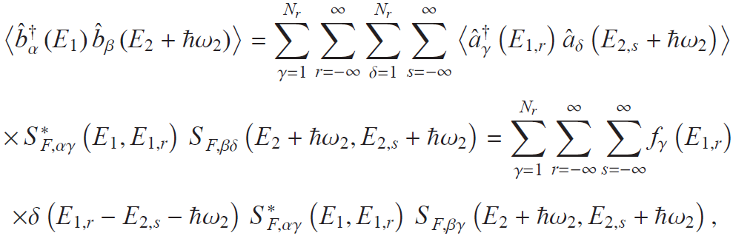
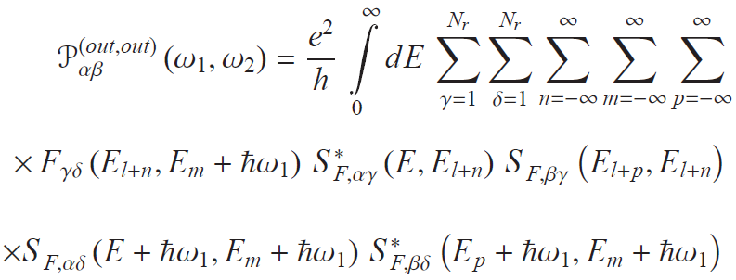
Noise spectral power
For example:
After all we get:

Slide 11
Noise spectral power
So we got back the following expression:

Slide 12
Zero frequency noise spectral power
Definition:
Autocorrelator / symmetrized cross-correlator,
l = 0, ω₁= ω₂=0 case of the big ugly expression we worked for,
Symmetrized correlator:
Sum of thermal and shot noise:

Slide 13
Zero frequency noise spectral power
Temperatures and chemical potencials are the same:
Hence the Fermi-functions are the same in the reservoirs:
l = 0, ω₁= ω₂=0 :
Thermal noise: vanishes at zero temperature,
Shot noise in equilibrium:

Slide 14
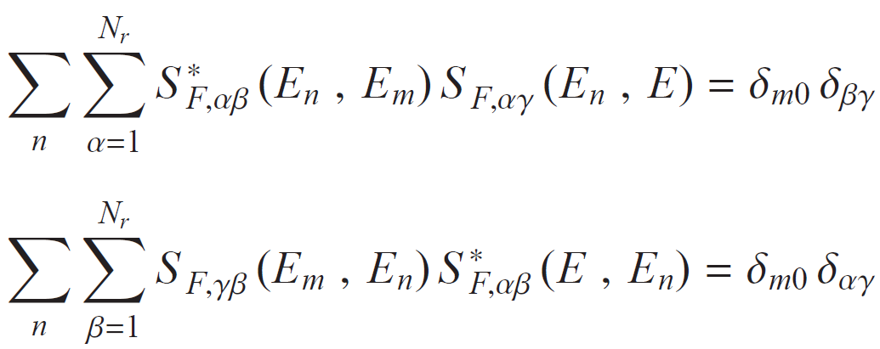
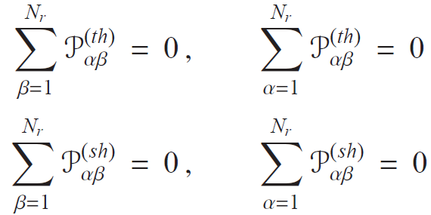
Zero frequency noise spectral power
Unitarity for S:
Conservation laws:
It’s true separately for the two noises!

Slide 15
Zero frequency noise spectral power
Analyze the sign of these terms:
For the thermal noise:
And for the shot noise:

Slide 16
Zero frequency noise spectral power
Autocorrelators:
We got:
Thermal and shot noise satisfy sum rules, sign rules separately,
They differ in their temperature dependence,
And also in the driving frequency dependence,
It is justified to split the noise into these two parts.

Slide 17
Thank you for your attention!

