Slide 1
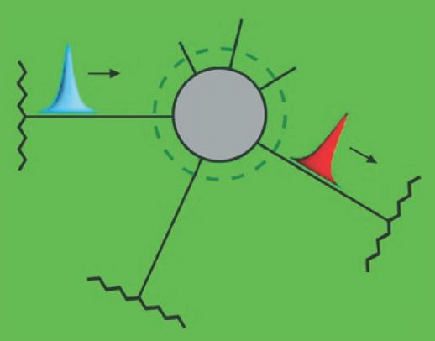
1. Landauer-Büttiker formalism Examples
Farkas Dániel Gergely
Msc physics student

Slide 2
Contents
Difference of potencials
Difference of temperatures
Scattering matrix 1x1, 2x2, 3x3
Scatterer with two leads
Scatterer with potencial contact
Scatterer embedded in ring

Slide 3
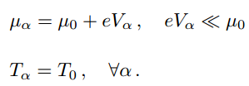
Difference of potencials
Starting point:
If pot. difference << temperature:
Than the current is:
where:
T = 0, easy case. V_{α} > 0: S₁₂(E) E-dependence is important.

Slide 4
Difference of temperatures
Similar case, now the temperature differs:
Fermi functions:
Current, and thermoelectric conductance:
²

Slide 5
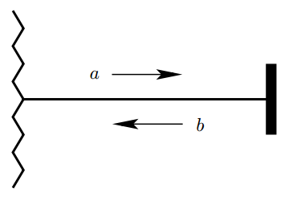
Scattering matrix 1x1
1 reservoir,
1 scattering channel,
=> 1x1 scattering matrix:
Total reflection, S₁₁: reflection coefficient.

Slide 6
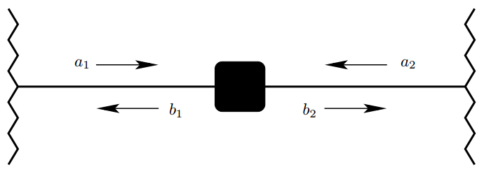
Scattering matrix 2x2
2 reservoir, 2x2 matrix, 8 parameter + unitarity.

Slide 7
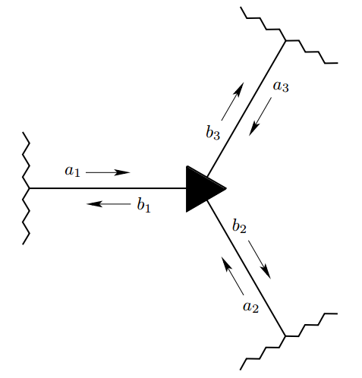
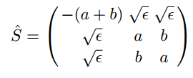
Scattering matrix 3x3
3 reservoirs, 9 matrix elements…
Example:
Reflection probabilities can be different!
T_{αβ} depends on transmission with the third lead.

Slide 8
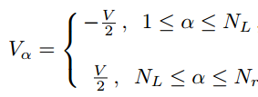
Scatterer with two leads
2 reservoirs, but N_{L} and N_{R} sub-bands,
T = 0, sum up to the sub-bands.

Slide 9
H dependence of conductance
Our goal:
Some quantities:
Identity + unitarity =>
Symmetry =>
Summary: ☺

Slide 10
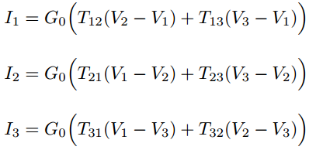
Scatterer with potencial contact
3 reservoir special case,
Motivation:
measurement in the sample => + contact, + problem
G₁₂ depends on scattering between 1,2 and 3!

Slide 11
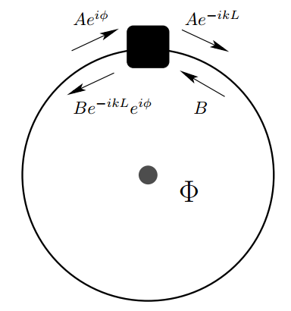
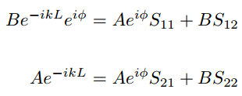
Scatterer embedded in ring
2 reservoir special case, H occurs,
Thin sample, wave function:
+ boundary conditions:
Magnetic flux equivalent with assymetry!

Slide 12
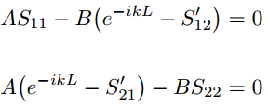
Scatterer embedded in ring
Spectrum of free electrons:
+ some nasty equations
Dispersion relation:
Current:

Slide 13
Thank you for your attention!

